Slide 1
Advertising Media Kit
2020

Slide 2

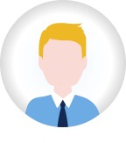

Who can you reach on Rigzone?
Audience
85% are actively looking for a job or managing their career*
Oil and gas professionals who are…
14.3K+ new members added each month
Active Job Seekers
Actively looking for a new job
Typically use Rigzone frequently
Search / apply for jobs; maintain updated resume
Career Managers
Happy in their role, but open to new opportunities
Read industry news and content
Look at relevant / interesting jobs
4.3+ million global members
1.2+ million average monthly site visits
1.9+ million active profiles
55% Americas
23% Europe/Africa
13% Middle East
9% APAC
AUDIENCE BY REGION
*% of Total Visits
Sources: Rigzone Employer Brand Survey, 2016 | Candidate database and Google Analytics, Q4 2019

Slide 3
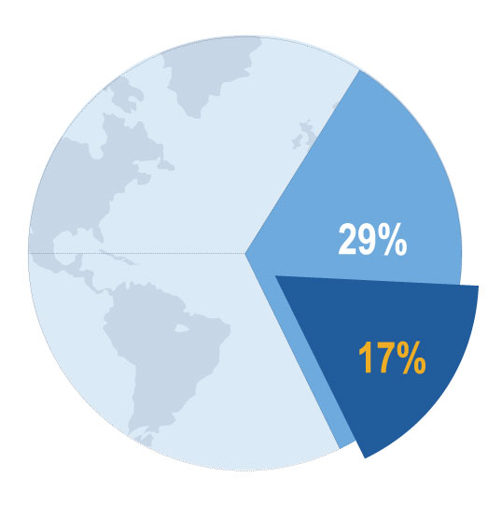

Experienced industry experts within all sectors
Audience
Well-balanced by gender and age:
Mid- and Downstream:
24% Female
76% Male
29% of Rigzone candidates work in Mid- and Downstream vs. 17% in overall industry***
Profiles by skill:
Highly experienced:
Sources: Google Analytics, Q4 2019 | Rigzone Database December 2019 | *** US only, Rigzone Employer Brand Survey, 2016 vs. IHS Economics
Notes:
Needs designing

Slide 4
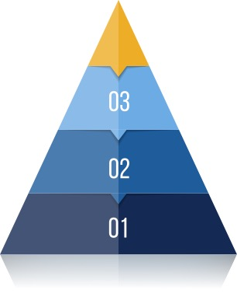
Why advertise on Rigzone?
Audience
Your reputation matters to professionals
More than 80%
of O&G pros think a company’s reputation matters a lot
85% of job seekers would even take a pay cut to work for a desired employer
85% of O&G professionals are always looking for a new/better opportunity
Branding & Recruitment Success
Find talent & customers
Source/Attract
Build a pipeline
Promote/Source
Niche career sites like Rigzone are the #1 resource for credible information about potential employers.*
Advertise your brand
Promote
*Source: Rigzone Employer Brand Survey, 2016

Slide 5


Advertising is the foundation for success
Product Overview
1. Promote - Advertise your recruitment and brand message
TARGETED DISPLAY ADS
TARGETED EMAILS
Drive site traffic from the right professionals
Get your message directly
to inboxes
FEATURED EMPLOYER PAGE
NEWSLETTER ADS
SPONSORED CONTENT
Stay top of mind with engaged professionals
Position your brand with a dedicated webpage
Blend seamlessly with Rigzone articles
2. Attract - Post jobs to attract the right talent
• Job Postings, Branded Job Postings, AutoPost
3. Source - Find quality professionals to fill your pipeline
• Candidate Database, Managed Services

Slide 6





Display Advertising
Products & Services
Raise brand awareness + drive relevant traffic to your site
Geographic Targeting
Advanced Targeting
Placement Targeting
Target people in your priority geographical regions
Make more impact as you drill down by region, country or state
Reach relevant professionals using category & skillset targeting
Target active job seekers that have shown interest in your company, or your competitors
Reach O&G Professionals during the job application journey
Homepage = prime visibility and higher share of voice
Pages by relevant audience = Energy News; Jobs; Training; Events; Marketplace or run of site placements
Monthly reporting on impressions, clicks and click-through rates (CTR)

Slide 7
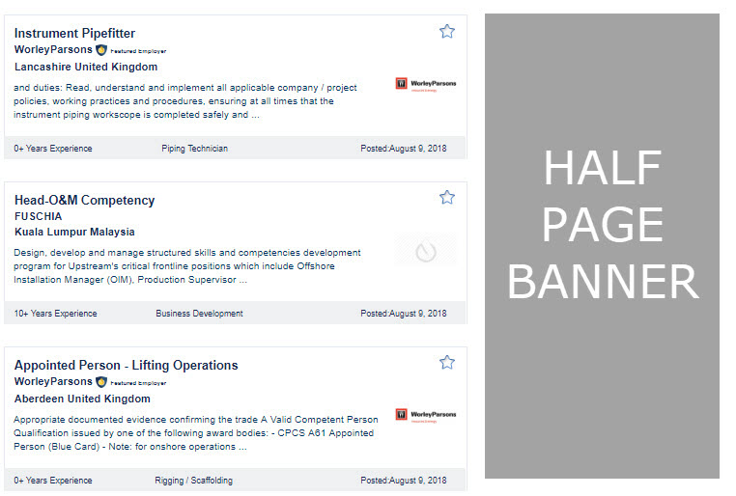
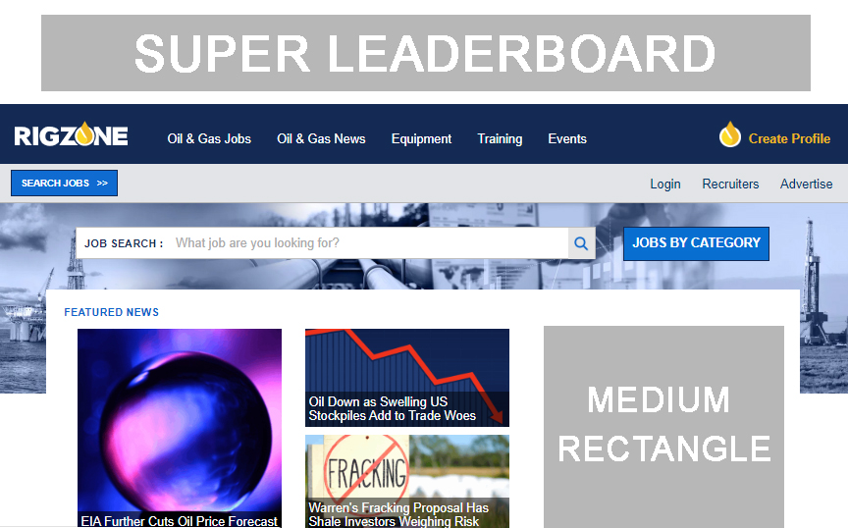
Rigzone Sponsorship
Products & Services
Maximize exposure with our premium 1-month advertising package
Homepage Medium Rectangle | 300 X 250
Super Leaderboard | 970 X 90
Mobile Banner | 320 X 50
Half Page | 300 X 600
Medium Rectangle | 300 X 250

Slide 8
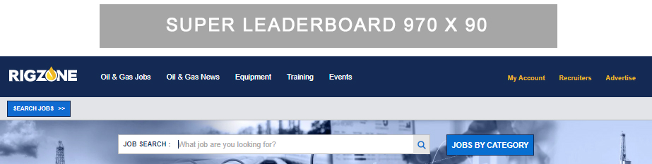
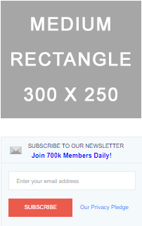
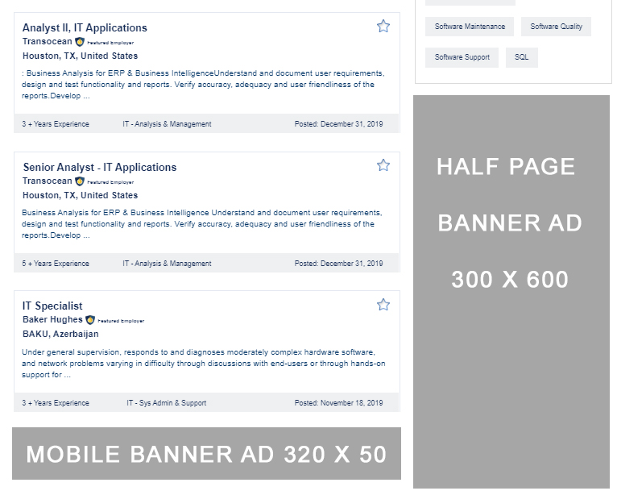
Jobs Sponsorship
Products & Services
Reach active candidates searching for new opportunities
Super Leaderboard | 970 x 90
Medium Rectangle | 300 x 250
Half Page Banner Ad | 300 x 600
Mobile Banner Ad | 320 x 50
Jobs Homepage Banner | 758 x 150

Slide 9
Site Section Sponsorships
Products & Services
Reach the audience most relevant to your message
970 x 90
970 x 90
728 x 90
300 x 600
300 x 600
728 x 90
Training Sponsorship
Events Sponsorship
Equipment Sponsorship
Super Leaderboard (970x90)*
Half Page (300x600)*
Custom Featured Training Profile*
Featured Events x15 with logo (150x150)*
*Training section only
Super Leaderboard (970x90)
Second Leaderboard (728x90)
Featured Event Listing with logo (150x150)
Super Leaderboard (970x90)*
Half Page on Equipment pages (300x600)*
Featured Company Profile with logo (150x150)*
Equipment Listings*
*Equipment section only

Slide 10
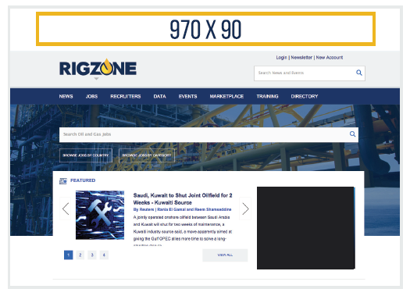
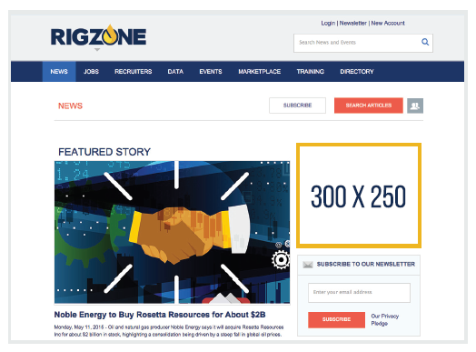
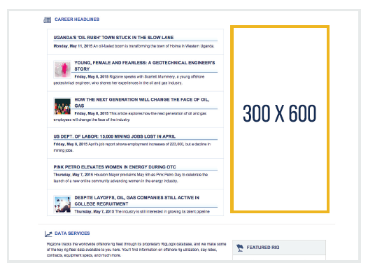
Homepage and Site Banner Bundles
Products & Services
Targeting Capabilities
Super Leaderboard
Strengths – by category & skillset
Brand Intenders – those who have searched jobs at your company or your competitors
Geo – region, country or state
Relevant section – ‘Energy News’ or ‘Jobs’
Exclusive homepage or highly visible ROS
100% above fold; reach visitors upon arrival
Medium Rectangle
Half Page
Prime ROS visibility across entire site
Homepage only w/ Rigzone Sponsorship
Key homepage position next to career news, or ROS available
Cost effective

Slide 11
Takeover
Products & Services
Takeover Breakdown
Super Leaderboard Banner
Half Page Banner
Medium Rectangle Banner
Footer Banner
758 x 150 Banner
Exclusive to your company
Visitors will engage with your banners on the first page they land on Rigzone.com
Seven day run-time
One takeover view per unique visit per 24 hours
Your brand will benefit from:
Cost-effective brand advertising
Exclusive homepage or highly visible ROS (super leaderboard)
100% above fold advertising, targeting visitors upon arrival (super leaderboard)
Key homepage position next to career news or ROS available (half page banner)
Prime ROS visibility across Rigzone.com
Homepage only w/ Rigzone Sponsorship (medium rectangle)

Slide 12
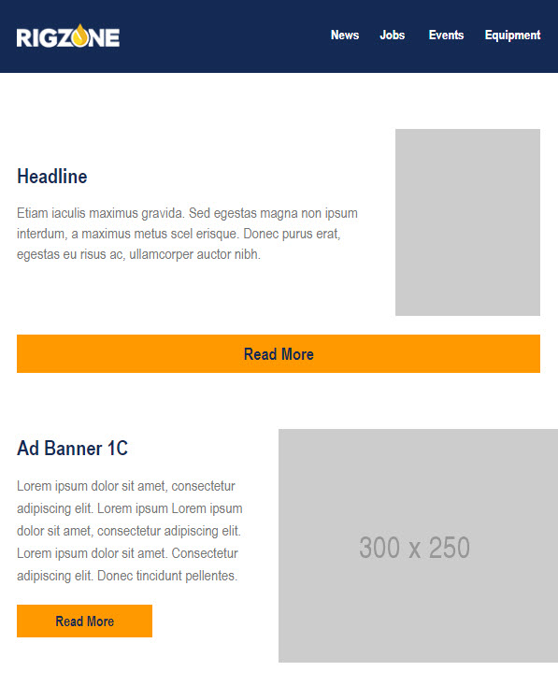

Newsletter Advertising
Products & Services
Stay top of mind with our range of newsletter ad options
Why advertise in Rigzone newsletters?
Engaged users
Regular opted-in readership
Broad reach through varied topics
Available Newsletters | Details
Daily industry news | 720K subscribers | Sent 7 days/week
Weekly news summary | 228K subscribers | Sent every Fri
Daily downstream news | 39.2K subscribers | Sent Mon-Fri
Weekly downstream summary | 33K subscribers | Sent every Fri
Weekly job register | 561K subscribers | Sent every Sat
What’s next in events? | 158K subscribers | Sent every first Thurs
Rigzone equipment update | 125K subscribers | Sent every Fri
Oil Price Daily Digest | 96K subscribers | Sent Mon-Fri
*Available placements vary by newsletter
Source: Rigzone database, Q4 2019

Slide 13

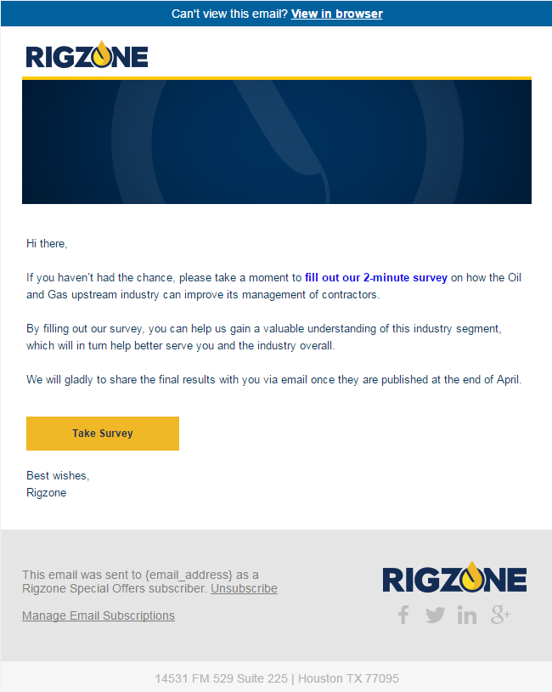
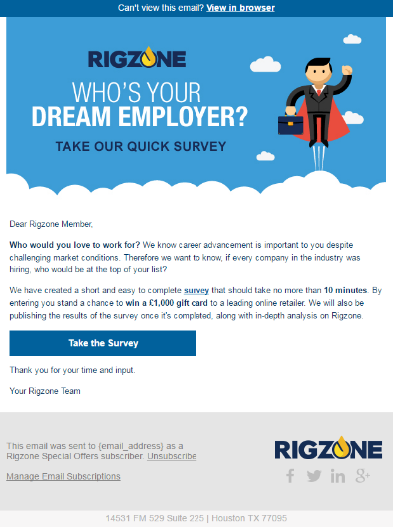
Targeted Emails
Products & Services
Broadcast your exclusive message to a captive oil & gas audience, directly to their inboxes
Choose from
1.93+ million
email subscribers
Select your audience by location and skill category
Options to reach
5K, 7.5K or 10K contacts
Your exclusive message
Tangible results – reporting on Send Count and Opens, Open Rate, Link Clicks
Your message and design goes straight to Rigzone members – you provide customized content in HTML format
Source: Rigzone database, Q4 2019

Slide 14
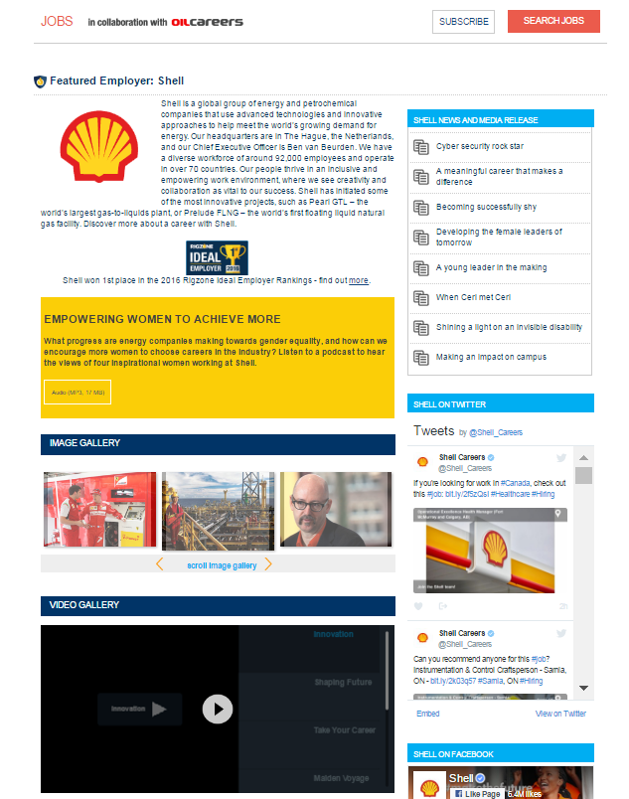
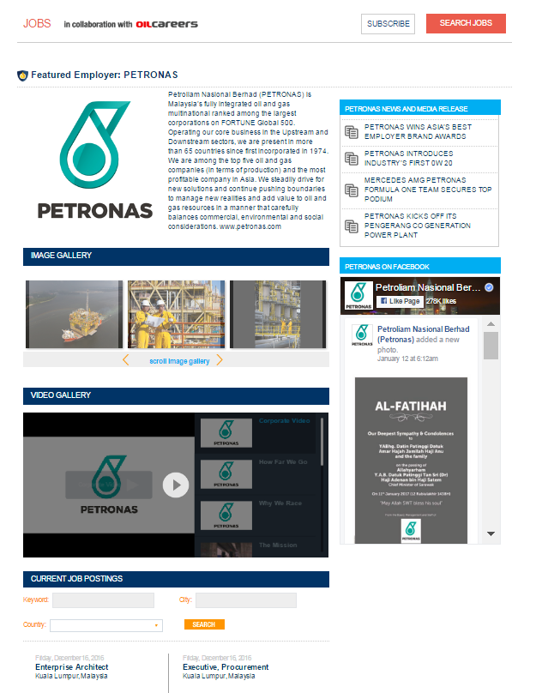
Featured Employer Page
Products & Services
Position and promote your brand with a dedicated page on Rigzone
Prominent logo placement with option to takeover display ads on page
Interactive page with photo, audio, video, and social integration options
Includes all your listed jobs in one convenient place
Pair with banner ads or job postings as a hub for company info

Slide 15



Sponsored Content
Products & Services
Tell your story with a custom article that blends seamlessly into Rigzone
Why is content powerful?
Trustworthy
Readers are increasingly receptive to in-feed sponsored content if it is relevant, authoritative and trustworthy.
Engaging
Content is able to “tell a story” to develop emotional engagement with its audience in way that traditional advertising cannot.
Innovative
Adopt an innovative marketing approach to promote your brand and capture social engagement via multiple platforms.
Amplification
Communicate through social media and professional networks to reach the widest audience and get the best return on investment for your content.
Engage existing audiences
Engage new audiences
Editorial expertise
Our global editorial team features regional experts who published more than 2,000 articles last year ranging from industry news to career advice.

Slide 16
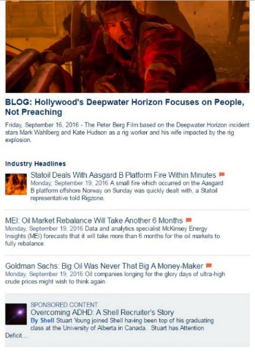
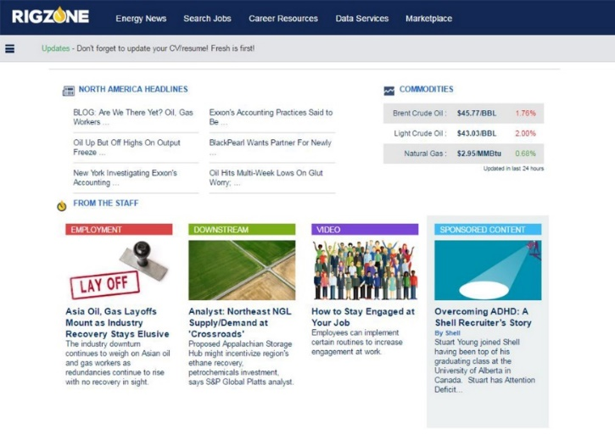






Sponsored Content
Products & Services
Readers see your article on Rigzone website and social channels
1.17+ million global monthly site visits
1.93+ million email subscribers
Sponsored Content Article
183,000+ page likes
97,000+ followers
179,000+ followers
Engagement through networks
Our global engagement team will amplify content through a range of email and social media channels to reach the widest relevant audience.
Source: Rigzone database, Q4 2019 | Social Media Official Channels

Slide 17


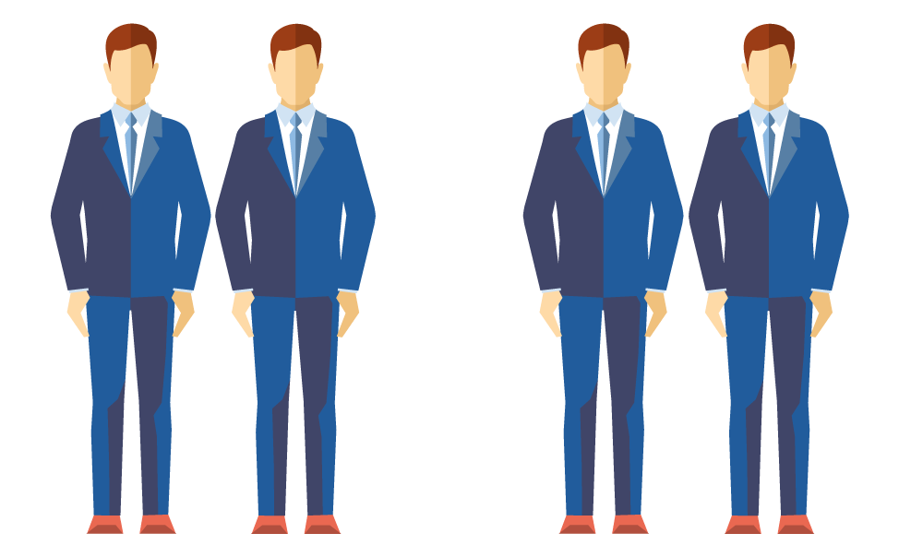

Sponsored Content
Products & Services
Your impact is measured through campaign reporting
Total and average time on page
How much time did a reader spend engaging with your content?
Social engagement
How many people liked, shared, commented, and tweeted about your content?
Total page views and engagement rate (%)
How many people looked at your content?
Audience insight
We’ve been communicating with our audience since 2009. We understand what interests them and, ultimately, which topics could generate the most engagement.

Slide 18



How Sponsored Content works
Products & Services
Content
1
Shape your themes and build articles with our expert content team
Features
Define the objective and theme of the campaign
2
Overview | Details
Content | Tailored articles written by Rigzone staff to specifically engage your target audience and achieve your messaging objectives
Campaign Duration | 4 weeks highlighted as a sponsored article
Client Content Control | Final sign off on topic, headline, article copy and images
Label | Sponsored Content
Byline | Client name
Amplification of Content, Social Networks | 4 weeks of amplification
Locations | Geo-targeted
Companion Banner Ads to Wrap Article Artwork provided by client | Super Leaderboard 970x90 Medium Rectangle 300x250 Footer Banner 728 x 90 PNG, JPG, GIF | File size >80KB
Measurement & Reporting | Total page views, average time on page, social engagement
3
Article approved by you
v
4
Article is published on Rigzone.com
5
Shared through Rigzone & client networks
Audience reads, shares, likes and comments
6
7
Generate engagement with your brand

